Slide 1
Session 1 – KLC Fundamentals Data Skills for Research Kellogg Research Support
July 8, 2024
Notes:
Welcome. We are so happy you’re here.
What you are about to hear next is about the closest you will get to a lecture in this workshop series. Most of the rest of this will be pretty interactive.
There will be discussions and you follow along with a demonstration, and maybe try to solve a few problems yourself.
But before we get into demonstrations of tools and how to apply them to your research work, I want to talk a bit about the reproducibility of that work you are about to start.
It is a very important topic, and I believe there are a few general principles that, if kept in mind, can help you quite a lot when you go to reproduce your work in the future.

Slide 2
4 Principles for Easier Replication
Document Everything!
Document what you are willing to keep updating
Definitely document your environment and use version control
Notes:
This should be obvious to everyone. You should always document your code, and more comments and read-me files is bound to make things easier for your future self. Right?
<pause for effect>
<CLICK>
Actually, NO! I maintain that less is more when it comes to documentation.
In any event, you ABSOLUTELY MUST maintain your documentation. So if you have got comments running throughout your code, that’s fine,
but you will need to update the comments each time you update the code. Otherwise, you run the risk of your code doing one thing and your comments saying another.
That is a sure fire recipe for confusion when you crack open your Python program for the first time in 24 months to figure out why the numbers are suddenly different.

Slide 3
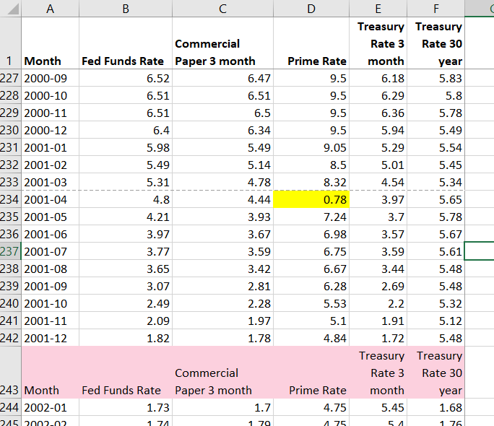
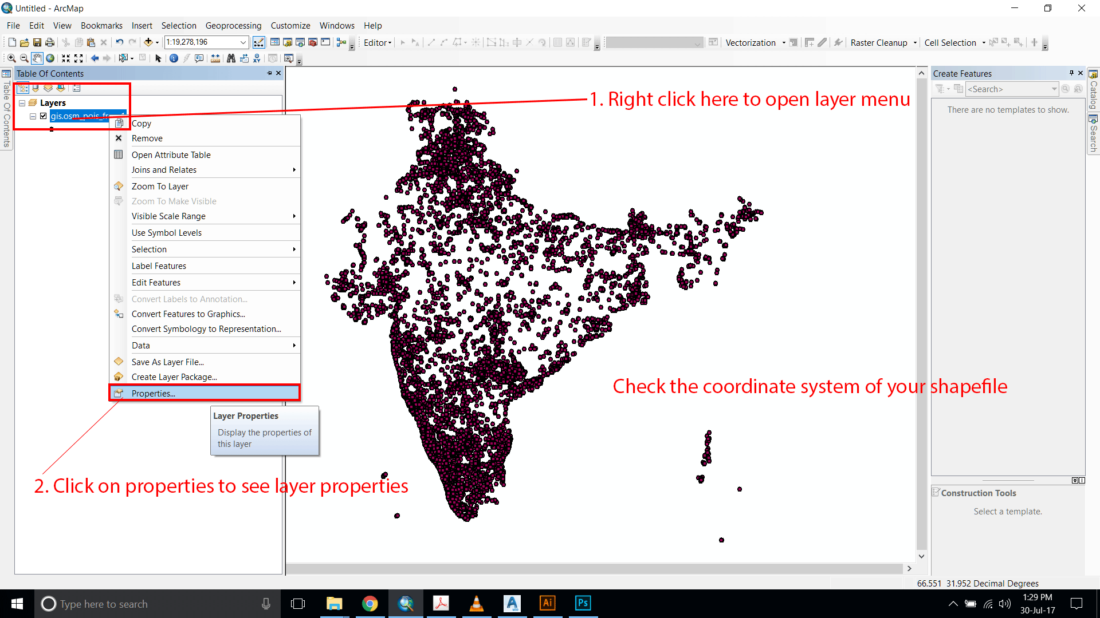
4 Principles for Easier Replication
Automate whenever possible
Notes:
This should be obvious to everyone. You should always document your code, and more comments and read-me files is bound to make things easier for your future self. Right?
<pause for effect>
<CLICK>
Actually, NO! I maintain that less is more when it comes to documentation.
In any event, you ABSOLUTELY MUST maintain your documentation. So if you have got comments running throughout your code, that’s fine,
but you will need to update the comments each time you update the code. Otherwise, you run the risk of your code doing one thing and your comments saying another.
That is a sure fire recipe for confusion when you crack open your Python program for the first time in 24 months to figure out why the numbers are suddenly different.

Slide 4
4 Principles for Easier Replication
use "/rawdata/2018/wages.dta, clear
keep if taxyear == 2018
generate lnwage = ln(wage)
Scatter lnwage tenure, title("ln(wages) versus Tenure, 2018")
regress lnwage educ gender tenure
regsave educ gender tenure using results,
table(OLS_stderr, order(regvars r2))
replace
use results, clear
outsheet using results_2018.txt, replace
Don't repeat yourself, abstract
Notes:
This should be obvious to everyone. You should always document your code, and more comments and read-me files is bound to make things easier for your future self. Right?
<pause for effect>
<CLICK>
Actually, NO! I maintain that less is more when it comes to documentation.
In any event, you ABSOLUTELY MUST maintain your documentation. So if you have got comments running throughout your code, that’s fine,
but you will need to update the comments each time you update the code. Otherwise, you run the risk of your code doing one thing and your comments saying another.
That is a sure fire recipe for confusion when you crack open your Python program for the first time in 24 months to figure out why the numbers are suddenly different.

Slide 5
4 Principles for Easier Replication
TEST
...every assumption about behavior of your data, code, and collaborators
Notes:
This should be obvious to everyone. You should always document your code, and more comments and read-me files is bound to make things easier for your future self. Right?
<pause for effect>
<CLICK>
Actually, NO! I maintain that less is more when it comes to documentation.
In any event, you ABSOLUTELY MUST maintain your documentation. So if you have got comments running throughout your code, that’s fine,
but you will need to update the comments each time you update the code. Otherwise, you run the risk of your code doing one thing and your comments saying another.
That is a sure fire recipe for confusion when you crack open your Python program for the first time in 24 months to figure out why the numbers are suddenly different.

Slide 6
All-Purpose Data Workflow
Never overwrite!
Extract | Collect Raw Data
Prep Data
for Analysis
Analyze
Data
Logging and testing via programs (version controlled)
Notes:
This should be obvious to everyone. You should always document your code, and more comments and read-me files is bound to make things easier for your future self. Right?
<pause for effect>
<CLICK>
Actually, NO! I maintain that less is more when it comes to documentation.
In any event, you ABSOLUTELY MUST maintain your documentation. So if you have got comments running throughout your code, that’s fine,
but you will need to update the comments each time you update the code. Otherwise, you run the risk of your code doing one thing and your comments saying another.
That is a sure fire recipe for confusion when you crack open your Python program for the first time in 24 months to figure out why the numbers are suddenly different.

Slide 7
KLC Demonstration

Slide 8
Conclusion
Programs can automate manual processes, including documentation
2. Abstraction and testing are important program elements
3. Use version control and package managers
4. Use KLC instead of your laptop
5. Never overwrite your original data
Notes:
This should be obvious to everyone. You should always document your code, and more comments and read-me files is bound to make things easier for your future self. Right?
<pause for effect>
<CLICK>
Actually, NO! I maintain that less is more when it comes to documentation.
In any event, you ABSOLUTELY MUST maintain your documentation. So if you have got comments running throughout your code, that’s fine,
but you will need to update the comments each time you update the code. Otherwise, you run the risk of your code doing one thing and your comments saying another.
That is a sure fire recipe for confusion when you crack open your Python program for the first time in 24 months to figure out why the numbers are suddenly different.

